Slide 1
TITLE
TEAM ID : H26EDU15
PROJECT TITLE : ADAPTIVE MULTIMODEL STUDENT
UNDERSTANDING VERIFICATION NETWORK
TEAM NAME : VORTEX
TEAM LEAD NAME : JAYASURIYA S
TEAM MEMBERS : ATHITHYA T
KALAIYARASAN B
COLLEGE NAME : M.KUMARASAMY COLLEGE
OF ENGINEERING

Slide 2
PROBLEM STATEMENT
Traditional Artificial Intelligence (AI) based Intelligent Tutoring System evaluate learners based on quiz results and correctness of answers providing no information about conceptual understanding, reasoning ability and level of learning.
ITS does not offer education content based on the learners’ interest, learning style, proficiency, and language of choice causing a low level of participation and ineffective knowledge transfer.
The current systems do not adequately verify understanding by utilizing speech, eye-tracking, semantics, reasoning and learning patterns to determine if the learner successfully understood the concepts. Systems do not effectively identify misconceptions, shortcomings in knowledge, and provide recommendations for individual learners.
An AI-based intelligent framework is necessary to evaluate understanding via multiple sources of communications, detect learners misconceptions and knowledge gaps.
The proposed Adaptive Understanding Verification Algorithm and offer an explainable, personalized, multilingual and adaptive learning experience to effectively address individual learning needs, preferences, interests, and progress.

Slide 3
EXISTING SYSTEM
Existing Artificial Intelligence based Intelligent Tutoring Systems usually analyze the user on the basis of quiz scores, objective-type tests, and the accuracy of the response given by the students.
The systems are usually based on keyword or rule-based answers analysis, where a student's response is matched against a standard answer rather than analyzing their meaning and depth of understanding.
Intelligent Tutoring Systems offer the same type of learning material and teaching methodologies irrespective of the student's interests, preferences, level of understanding, skill, and language.
Some systems offer automated quizzes and feedback, but the quizzes are mostly score-based and do not analyze the reasoning capabilities of the student and his/her level of comprehension.

Slide 4
IDENTIFICATION GAP
Despite the various benefits of AI-driven learning, modern intelligent tutoring systems are limited in several ways. First of all, they are unable to properly assess the understanding of the material, since they only take into account the number of correct answers.
Moreover, these tutoring systems do not take into account the speech and attention of students, their semantic, logical and learning skills during the learning process.
The systems cannot detect understanding and lack of understanding and give individual recommendations and explanations of accompanying errors.
Using the same content, methods of teaching and languages ​​fails to provide a high degree of personalization and engagement.
In this regard, it is necessary to develop an intelligent learning system that would support multimodal student modeling and thus provide a more engaging and personalized learning experience, as well as offer to communicate in different languages ​​and provide explanations.

Slide 5
SYSTEM DESIGN
Analysis
Analysis
DeBerta Transformer
Student Login
Attention
Answer Text
Misconception Detection
Topic Selection
MediaPipe
Whisper STT
Knowledge Gap Analysis
Concept Learning
Video
Audio
AUVA Multimodel Fusion
Generated
Questions
Verification
Final AI Report

Slide 6
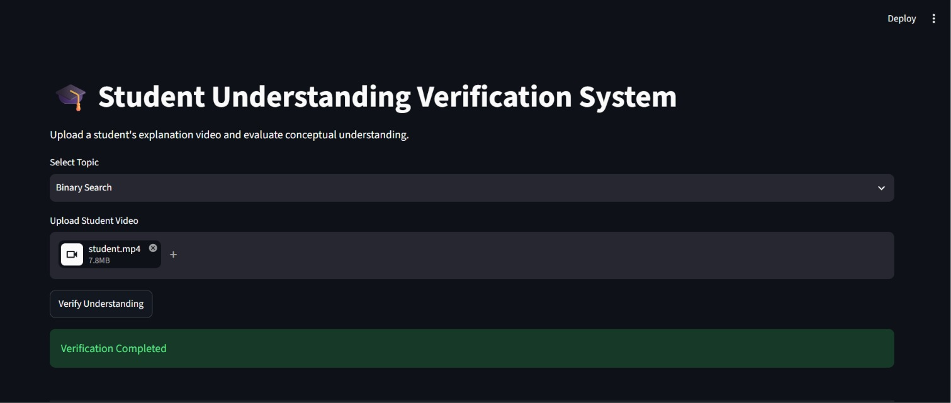
IMPLEMENTATION PROGRESS

Slide 7
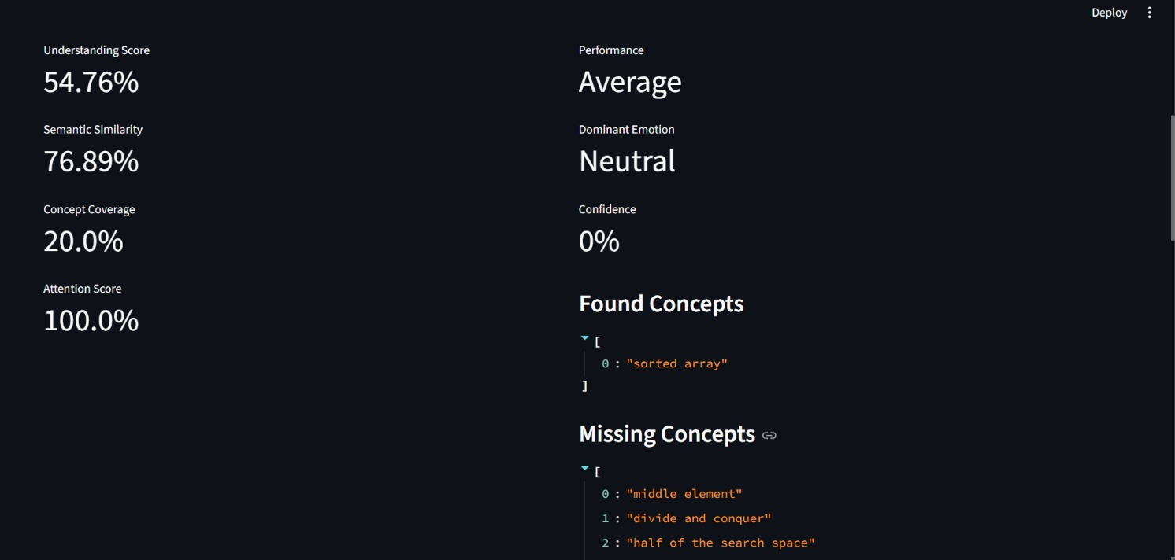
IMPLEMENTATION PROGRESS

Slide 8
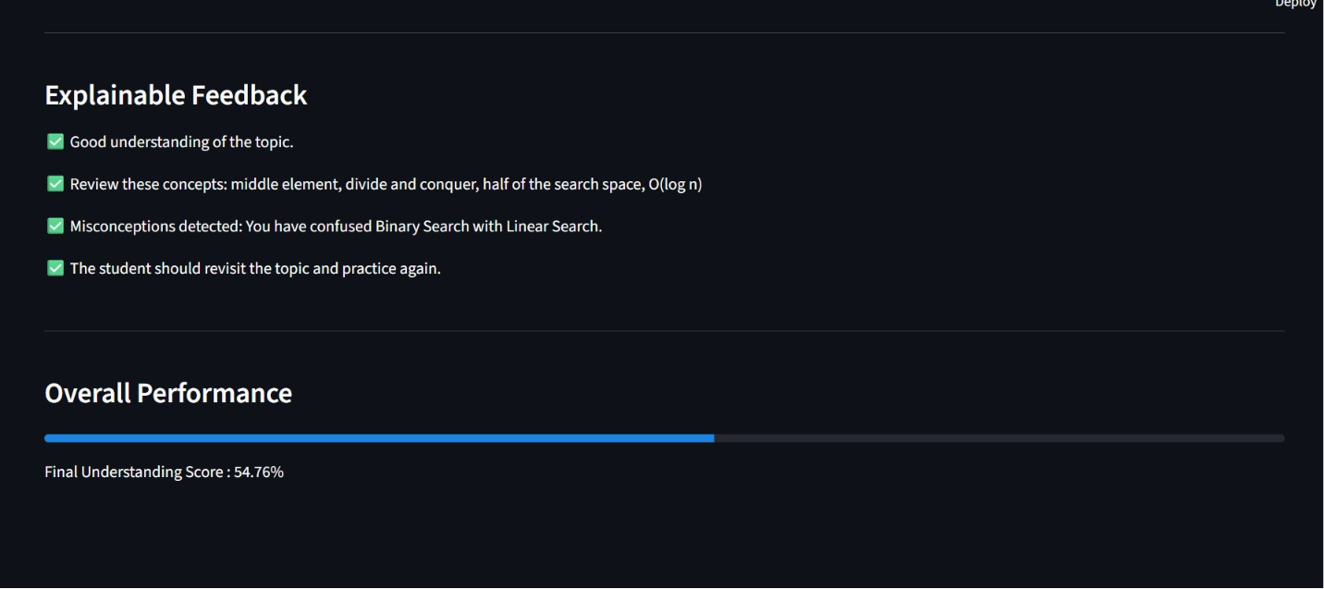
IMPLEMENTATION PROGRESS

Slide 9
PRODUCT DEVELOPMET
Develop AUVA as a cloud-based AI Learning Platform. Provide personalized learning through web and mobile applications.
Integrate with Learning Management Systems (LMS).
Offer real-time conceptual understanding verification and analytics.
Support multilingual AI-assisted learning. Generate explainable feedback and adaptive learning paths.
Enable deployment for schools, colleges, online learning platforms, and corporate training.

